Slide 1
Assignment on Carry4 primitive
Made the changes suggested for carry4 assignment

Slide 2
The carry4 primitive has the following pins-
Port | Direction | Width | Function
O | Output | 4 | Carry chain XOR general data out
CO | Output | 4 | Carry-out of each stage of the carry chain
DI | Input | 4 | Carry-MUX data input
S | Input | 4 | Carry-MUX select line
CYINIT | Input | 1 | Carry-in initialization input
CI | Input | 1 | Carry cascade input
26-09-2019
TIFR-FCRIT

Slide 3
Changes made to the code-
The most important change made to the code is that we cascaded four carry4 primitives instead of one.
The input signal is entered into the first carry4 primitive using the CYINIT input pin.
The carry output CO[3] pin of each carry4 primitive is connected to the CI input pin of the next carry4 primitive in the chain.

Slide 4
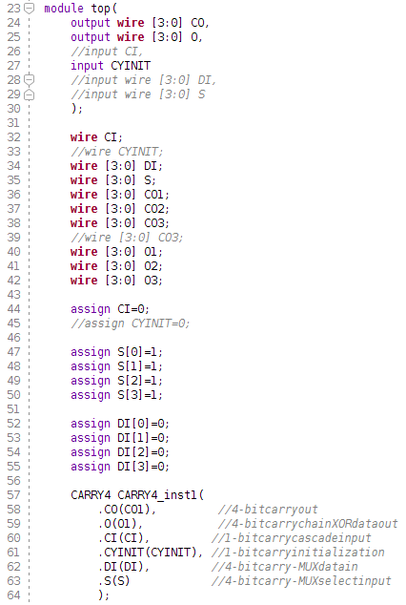
Our code-

Slide 5
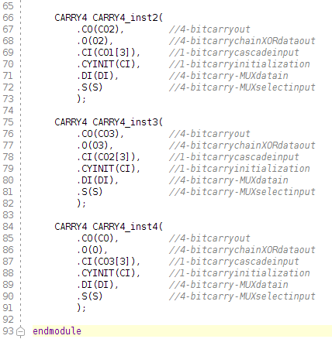
Our code-

Slide 6
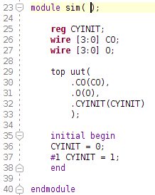
The simulation code-

Slide 7
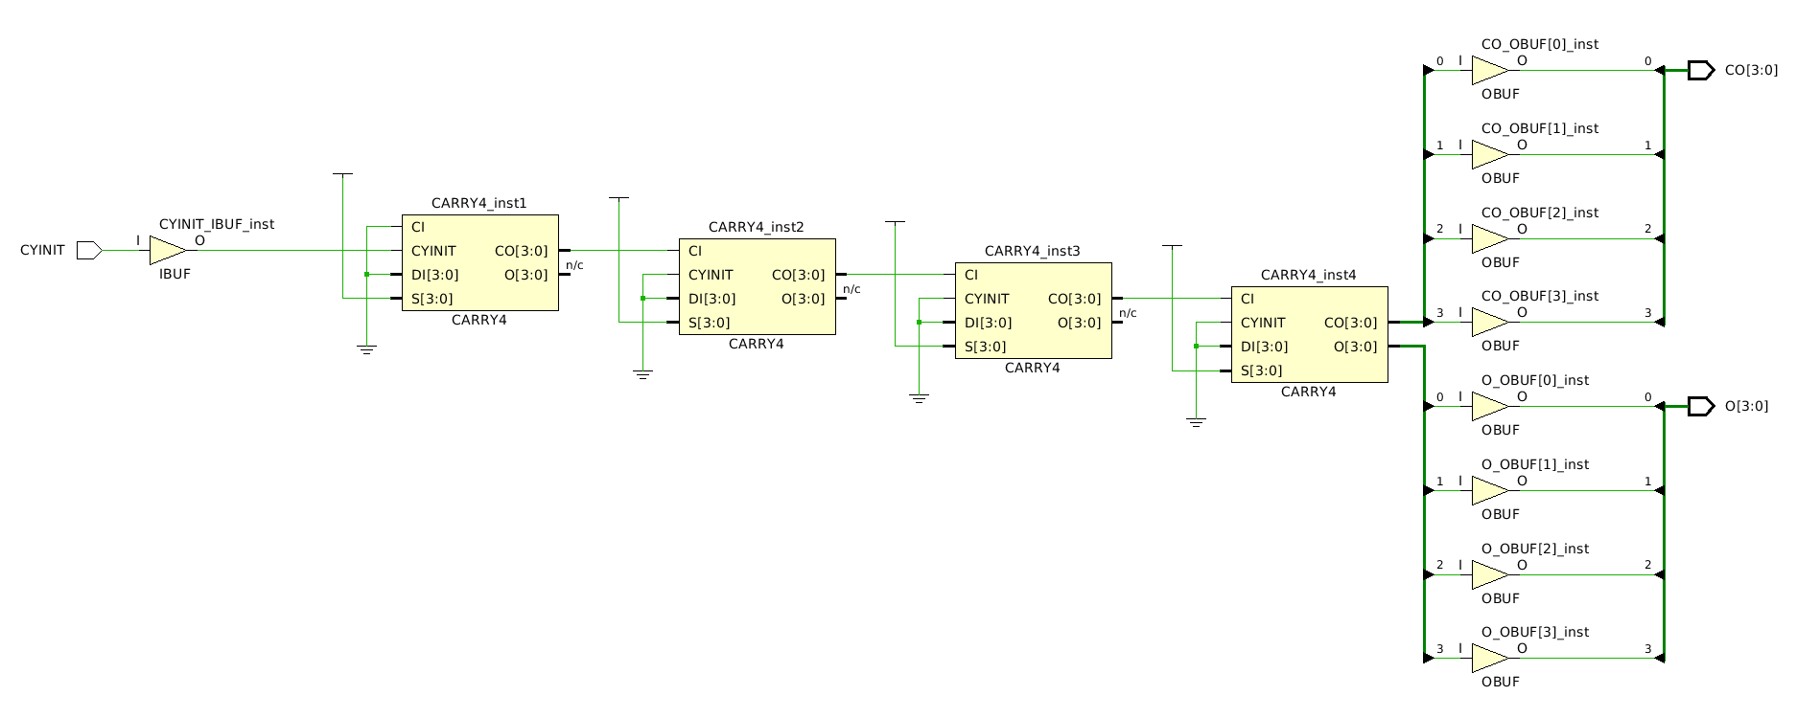
Schematic-

Slide 8
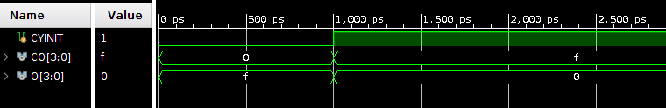
Behavioral simulation-

Slide 9
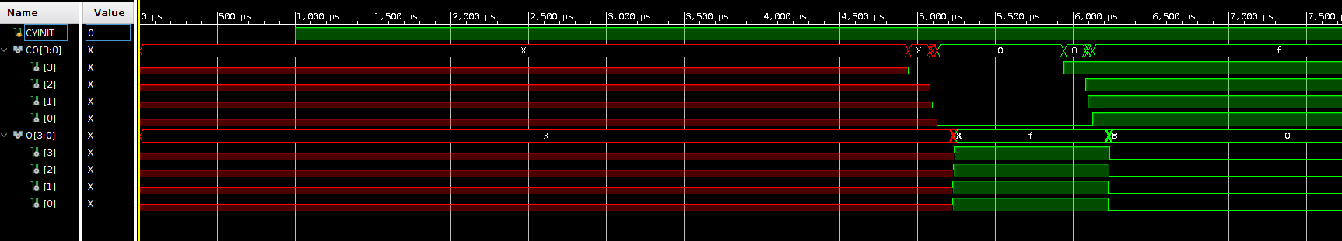
Post-synthesis timing simulation-

Slide 10
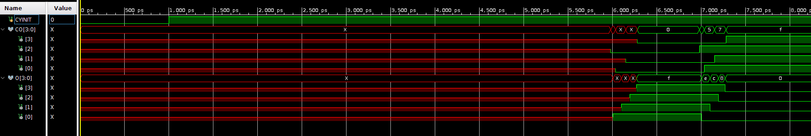
Post-implementation timing simulation-

